Slide 1
Overview
Guided - wire
Unguided - wireless
Characteristics and quality determined by medium and signal
For guided, the medium is more important
For unguided, the bandwidth produced by the antenna is more important
Key concerns are data rate and distance

Slide 2
Design Factors
Bandwidth
Higher bandwidth gives higher data rate
Transmission impairments
Attenuation
Interference
Number of receivers
In guided media
More receivers (multi-point) introduce more attenuation

Slide 3
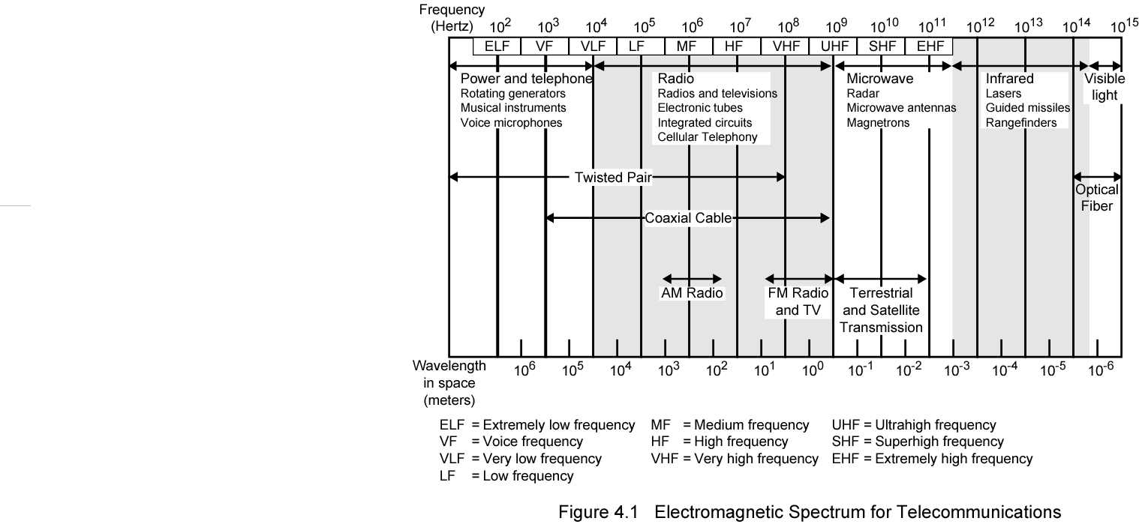
Electromagnetic Spectrum

Slide 4
Guided Transmission Media
Twisted Pair
Coaxial cable
Optical fiber

Slide 5
Transmission Characteristics of Guided Media
Frequency Range
Typical Attenuation
Typical Delay
Repeater Spacing
Twisted pair (with loading)
0 to 3.5 kHz
0.2 dB/km @ 1 kHz
50 µs/km
2 km
Twisted pairs (multi-pair cables)
0 to 1 MHz
0.7 dB/km @ 1 kHz
5 µs/km
2 km
Coaxial cable
0 to 500 MHz
7 dB/km @ 10 MHz
4 µs/km
1 to 9 km
Optical fiber
186 to 370 THz
0.2 to 0.5 dB/km
5 µs/km
40 km

Slide 6
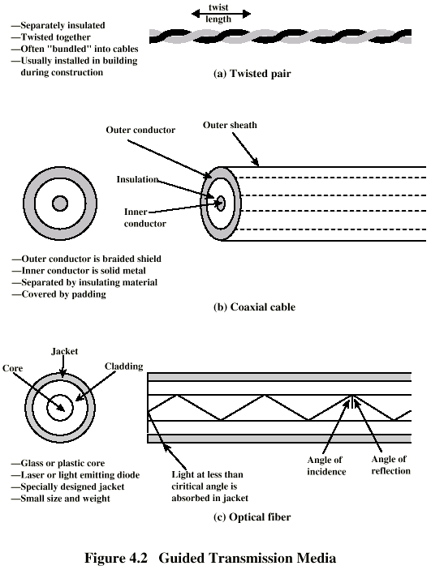
Twisted Pair

Slide 7
Twisted Pair - Applications
Most common medium
Telephone network
Between house and local exchange (subscriber loop)
Within buildings
To private branch exchange (PBX)
For local area networks (LAN)
10Mbps or 100Mbps

Slide 8
Twisted Pair - Pros and Cons
Cheap
Easy to work with
Low data rate
Short range

Slide 9
Twisted Pair - Transmission Characteristics
Analog
Amplifiers every 5km to 6km
Digital
Use either analog or digital signals
repeater every 2km or 3km
Limited distance
Limited bandwidth (1MHz)
Limited data rate (100MHz)
Susceptible to interference and noise

Slide 10
Near End Crosstalk
Coupling of signal from one pair to another
Coupling takes place when transmit signal entering the link couples back to receiving pair
i.e. near transmitted signal is picked up by near receiving pair

Slide 11
Unshielded and Shielded TP
Unshielded Twisted Pair (UTP)
Ordinary telephone wire
Cheapest
Easiest to install
Suffers from external EM interference
Shielded Twisted Pair (STP)
Metal braid or sheathing that reduces interference
More expensive
Harder to handle (thick, heavy)

Slide 12
UTP Categories
Cat 3
up to 16MHz
Voice grade found in most offices
Twist length of 7.5 cm to 10 cm
Cat 4
up to 20 MHz
Cat 5
up to 100MHz
Commonly pre-installed in new office buildings
Twist length 0.6 cm to 0.85 cm
Cat 5E (Enhanced) –see tables
Cat 6
Cat 7

Slide 13
Comparison of Shielded and Unshielded Twisted Pair
Attenuation (dB per 100 m)
Near-end Crosstalk (dB)
Frequency (MHz)
Category 3 UTP
Category 5 UTP
150-ohm STP
Category 3 UTP
Category 5 UTP
150-ohm STP
1
2.6
2.0
1.1
41
62
58
4
5.6
4.1
2.2
32
53
58
16
13.1
8.2
4.4
23
44
50.4
25
—
10.4
6.2
—
41
47.5
100
—
22.0
12.3
—
32
38.5
300
—
—
21.4
—
—
31.3

Slide 14
Twisted Pair Categories and Classes
Category 3 Class C
Category 5 Class D
Category 5E
Category 6 Class E
Category 7 Class F
Bandwidth
16 MHz
100 MHz
100 MHz
200 MHz
600 MHz
Cable Type
UTP
UTP/FTP
UTP/FTP
UTP/FTP
SSTP
Link Cost (Cat 5 =1)
0.7
1
1.2
1.5
2.2

Slide 15
Coaxial Cable

Slide 16
Coaxial Cable Applications
Most versatile medium
Television distribution
Ariel to TV
Cable TV
Long distance telephone transmission
Can carry 10,000 voice calls simultaneously
Being replaced by fiber optic
Short distance computer systems links
Local area networks

Slide 17
Coaxial Cable - Transmission Characteristics
Analog
Amplifiers every few km
Closer if higher frequency
Up to 500MHz
Digital
Repeater every 1km
Closer for higher data rates

Slide 18
Optical Fiber

Slide 19
Optical Fiber - Benefits
Greater capacity
Data rates of hundreds of Gbps
Smaller size & weight
Lower attenuation
Electromagnetic isolation
Greater repeater spacing
10s of km at least

Slide 20
Optical Fiber - Applications
Long-haul trunks
Metropolitan trunks
Rural exchange trunks
Subscriber loops
LANs

Slide 21
Optical Fiber - Transmission Characteristics
Act as wave guide for 10¹⁴ to 10¹⁵ Hz
Portions of infrared and visible spectrum
Light Emitting Diode (LED)
Cheaper
Wider operating temp range
Last longer
Injection Laser Diode (ILD)
More efficient
Greater data rate
Wavelength Division Multiplexing

Slide 22
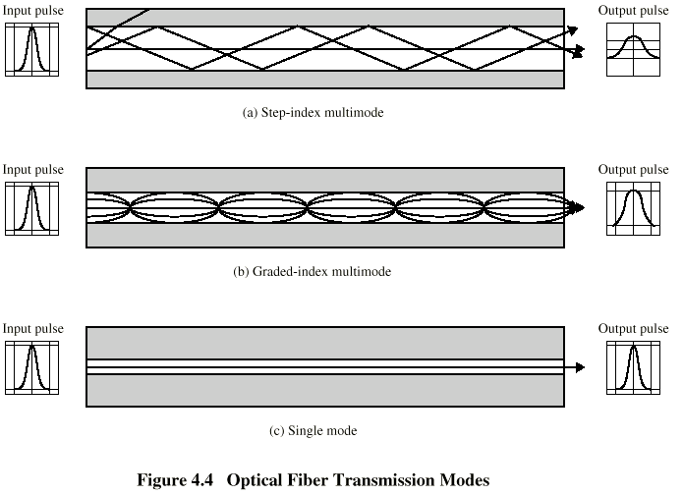
Optical Fiber Transmission Modes

Slide 23
Frequency Utilization for Fiber Applications
Wavelength (in vacuum) range (nm)
Frequency range (THz)
Band label
Fiber type
Application
820 to 900
366 to 333
Multimode
LAN
1280 to 1350
234 to 222
S
Single mode
Various
1528 to 1561
196 to 192
C
Single mode
WDM
1561 to 1620
185 to 192
L
Single mode
WDM

Slide 24
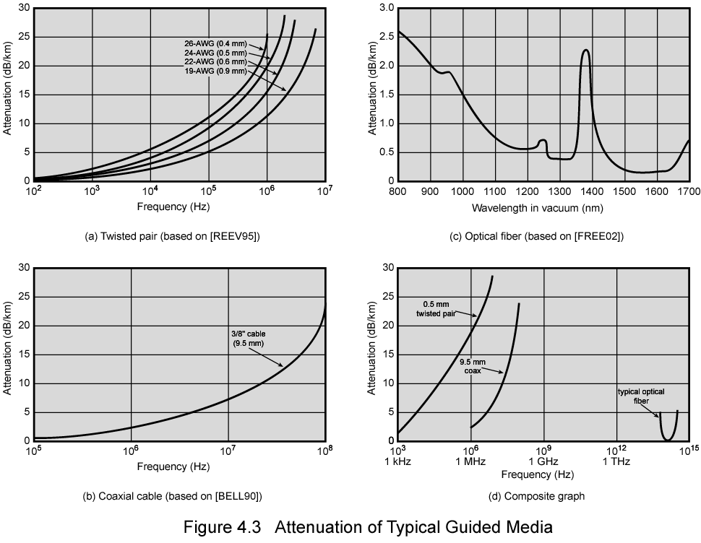
Attenuation in Guided Media

Slide 25
Wireless Transmission Frequencies
2GHz to 40GHz
Microwave
Highly directional
Point to point
Satellite
30MHz to 1GHz
Omnidirectional
Broadcast radio
3 x 10¹¹ to 2 x 10¹⁴
Infrared
Local

Slide 26
Antennas
Electrical conductor (or system of..) used to radiate electromagnetic energy or collect electromagnetic energy
Transmission
Radio frequency energy from transmitter
Converted to electromagnetic energy
By antenna
Radiated into surrounding environment
Reception
Electromagnetic energy impinging on antenna
Converted to radio frequency electrical energy
Fed to receiver
Same antenna often used for both

Slide 27
Radiation Pattern
Power radiated in all directions
Not same performance in all directions
Isotropic antenna is (theoretical) point in space
Radiates in all directions equally
Gives spherical radiation pattern

Slide 28
Parabolic Reflective Antenna
Used for terrestrial and satellite microwave
Parabola is locus of point equidistant from a line and a point not on that line
Fixed point is focus
Line is directrix
Revolve parabola about axis to get paraboloid
Cross section parallel to axis gives parabola
Cross section perpendicular to axis gives circle
Source placed at focus will produce waves reflected from parabola in parallel to axis
Creates (theoretical) parallel beam of light/sound/radio
On reception, signal is concentrated at focus, where detector is placed

Slide 29
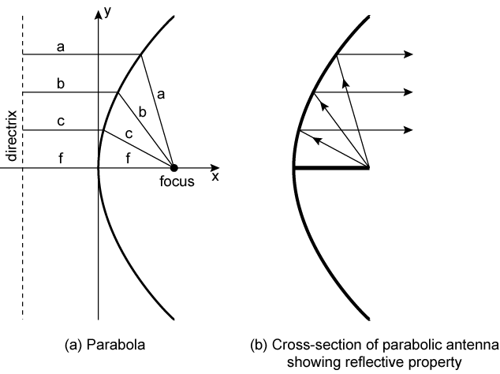
Parabolic Reflective Antenna

Slide 30
Antenna Gain
Measure of directionality of antenna
Power output in particular direction compared with that produced by isotropic antenna
Measured in decibels (dB)
Results in loss in power in another direction
Effective area relates to size and shape
Related to gain

Slide 31
Terrestrial Microwave
Parabolic dish
Focused beam
Line of sight
Long haul telecommunications
Higher frequencies give higher data rates

Slide 32
Satellite Microwave
Satellite is relay station
Satellite receives on one frequency, amplifies or repeats signal and transmits on another frequency
Requires geo-stationary orbit
Height of 35,784km
Television
Long distance telephone
Private business networks

Slide 33
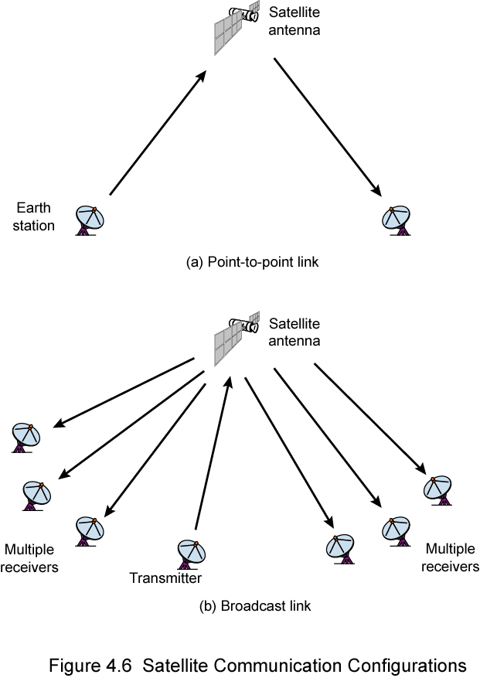
Satellite Point to Point Link

Slide 34
Satellite Broadcast Link

Slide 35
Broadcast Radio
Omnidirectional
FM radio
UHF and VHF television
Line of sight
Suffers from multipath interference
Reflections

Slide 36
Infrared
Modulate noncoherent infrared light
Line of sight (or reflection)
Blocked by walls
e.g. TV remote control, IRD port

Slide 37
Wireless Propagation
Signal travels along three routes
Ground wave
Follows contour of earth
Up to 2MHz
AM radio
Sky wave
Amateur radio, BBC world service, Voice of America
Signal reflected from ionosphere layer of upper atmosphere
(Actually refracted)
Line of sight
Above 30Mhz
May be further than optical line of sight due to refraction
More later…

Slide 38
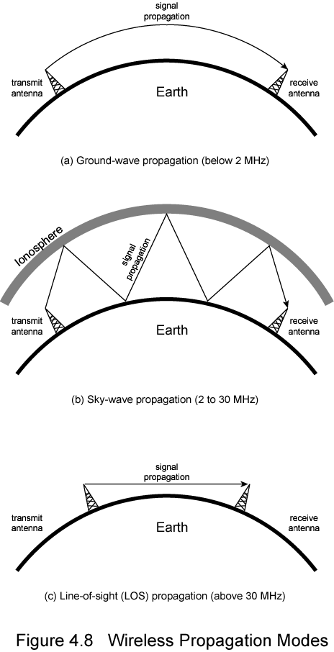
Ground Wave Propagation

Slide 39
Sky Wave Propagation

Slide 40
Line of Sight Propagation

Slide 41
Refraction
Velocity of electromagnetic wave is a function of density of material
~3 x 10⁸ m/s in vacuum, less in anything else
As wave moves from one medium to another, its speed changes
Causes bending of direction of wave at boundary
Towards more dense medium
Index of refraction (refractive index) is
Sin(angle of incidence)/sin(angle of refraction)
Varies with wavelength
May cause sudden change of direction at transition between media
May cause gradual bending if medium density is varying
Density of atmosphere decreases with height
Results in bending towards earth of radio waves

Slide 42
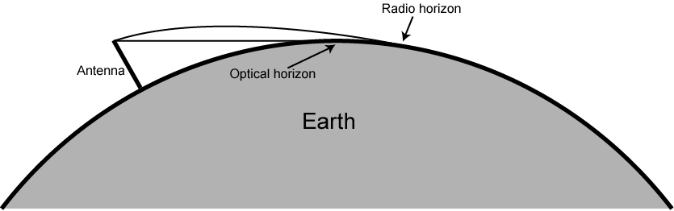
Optical and Radio Horizons

Slide 43
Line of Sight Transmission
Free space loss
Signal disperses with distance
Greater for lower frequencies (longer wavelengths)
Atmospheric Absorption
Water vapour and oxygen absorb radio signals
Water greatest at 22GHz, less below 15GHz
Oxygen greater at 60GHz, less below 30GHz
Rain and fog scatter radio waves
Multipath
Better to get line of sight if possible
Signal can be reflected causing multiple copies to be received
May be no direct signal at all
May reinforce or cancel direct signal
Refraction
May result in partial or total loss of signal at receiver

Slide 44
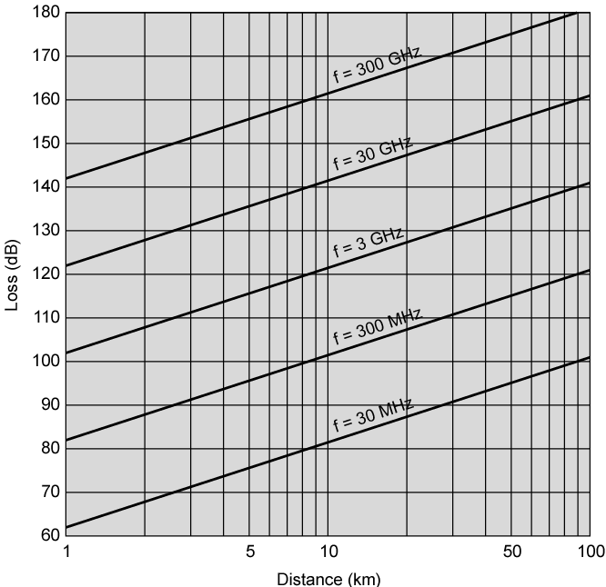
Free Space Loss

Slide 45
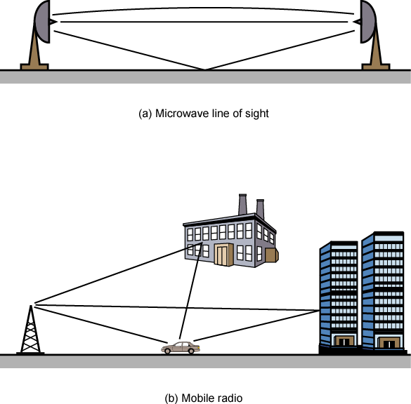
Multipath Interference

